Slide 1

EYFS Phonics and Reading meeting
Friday 4th October 2024
Mrs Toynbee and the EYFS Team

Slide 2
A love of reading is the biggest indicator of future academic success.
OECD (The Organisation for Economic Co-operation and Development)

Slide 3


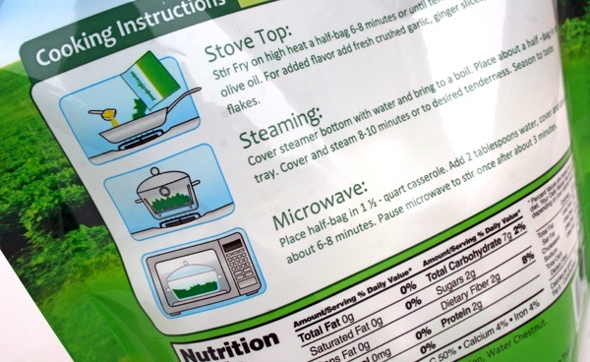
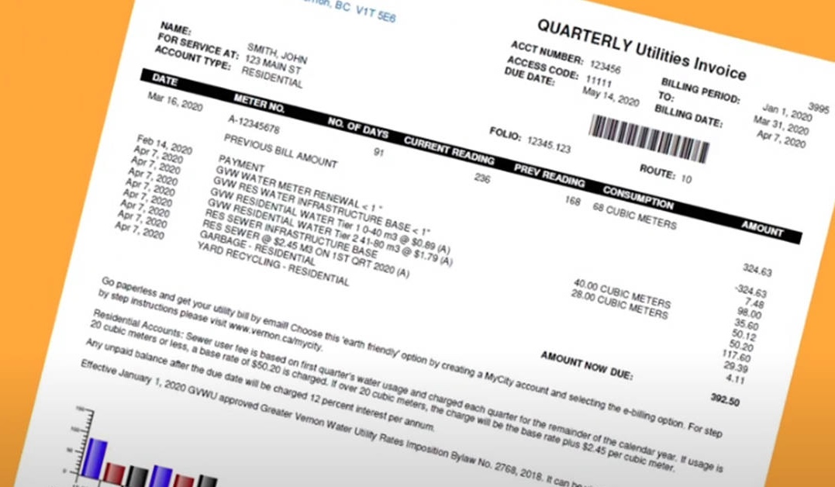
How many times have you already read today?
Notes:
Just think about how many times you have already read things today. It really is a vital skill.

Slide 4

Phonics

Slide 5
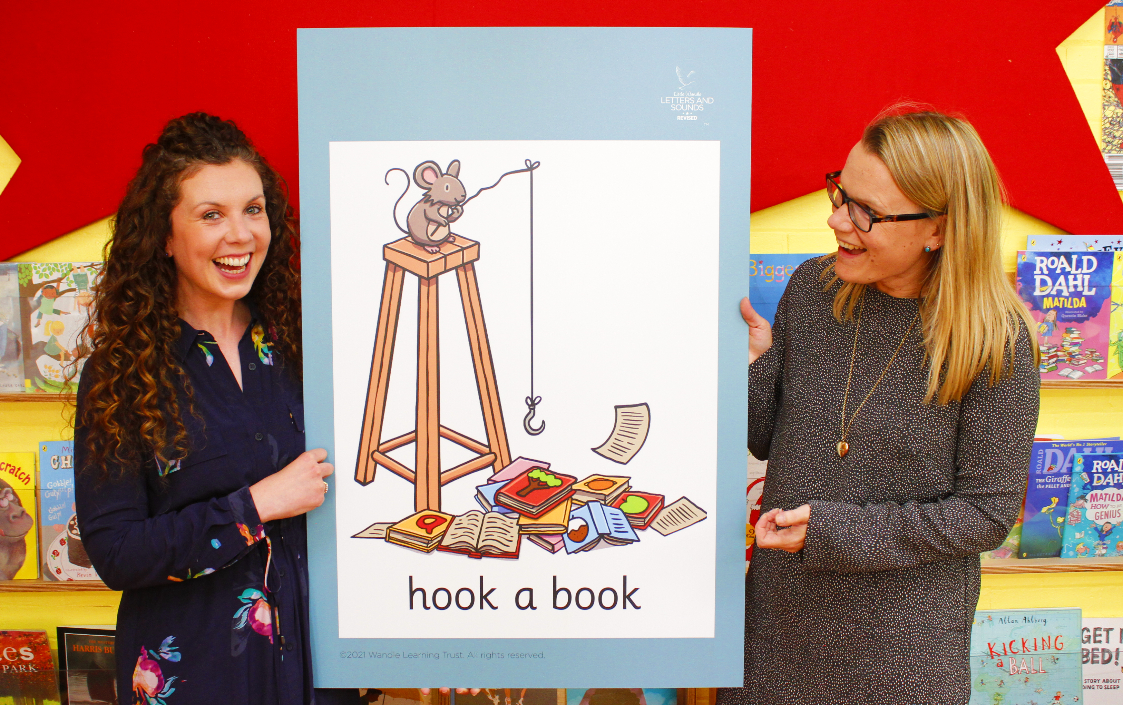
Little Wandle Letters and Sounds Revised
Our school has chosen Little Wandle Letters and Sounds Revised as our systematic, synthetic phonics (SSP) programme to teach early reading and spelling.

Slide 6
Phonics is:
making connections between the sounds of our spoken words and the letters that are used to write them down.
Notes:
It sounds complicated but it really isn’t!

Slide 7
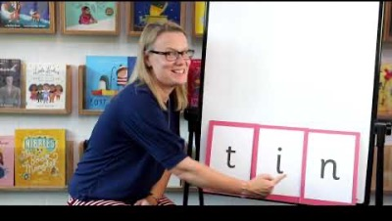
Blending to read words
Notes:
Some children learn to blend really quickly, and others take a little longer. If your child is finding it difficult, ask your child’s teacher for ways to help at home – playing blending games at home is so helpful!
Show parents this video from the website: https://www.littlewandlelettersandsounds.org.uk/resources/for-parents/

Slide 8
Terminology
Phoneme
Grapheme
Blend
Digraph
Segment
Trigraph
Notes:
Explain what each word means – use our glossary to help: https://www.littlewandlelettersandsounds.org.uk/resources/my-letters-and-sounds/getting-started/

Slide 9
Phoneme
Phoneme The smallest unit of sound that can be identified in words. We sometimes simply call this a ‘sound’, although it is helpful for children to use the term ‘phoneme’ from the beginning of our programme.
Grapheme
A letter or group of letters used to represent a particular phoneme when writing. With children, we sometimes call this ‘a sound written down’, although, as with ‘phoneme’, it is helpful for children to learn to use the correct term from the beginning. The way graphemes are used to represent phonemes in our written language is known as the ‘alphabetic code’.
Digraph
A grapheme using two letters to represent one phoneme. With children, we frequently reinforce it with the mantra ‘two letters, one sound’.

Slide 10
Trigraph
A grapheme using three letters to represent one phoneme. With children, we frequently reinforce it with the mantra ‘three letters, one sound’

Slide 11
Segmenting
To identify each of the individual phonemes in a word, working all the way through from left to right. This is an important first stage of writing (spelling) a word but needs to be practised orally first.
Blending
To combine individual phonemes into a whole word, working all the way through from left to right. Once the GPCs involved have been learned, blending is the key process involved in reading words effectively. It is a skill that needs extensive practice.

Slide 12
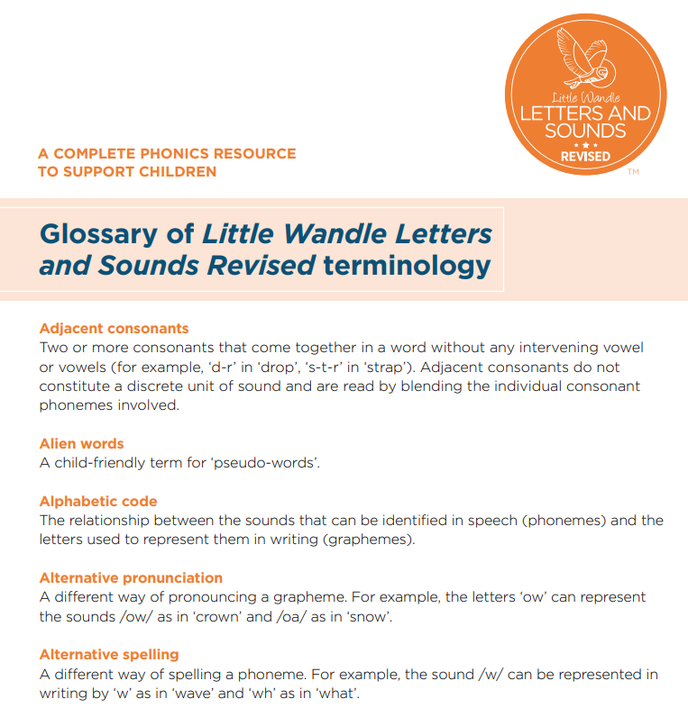
Take a look through the Little Wandle glossary!

Slide 13
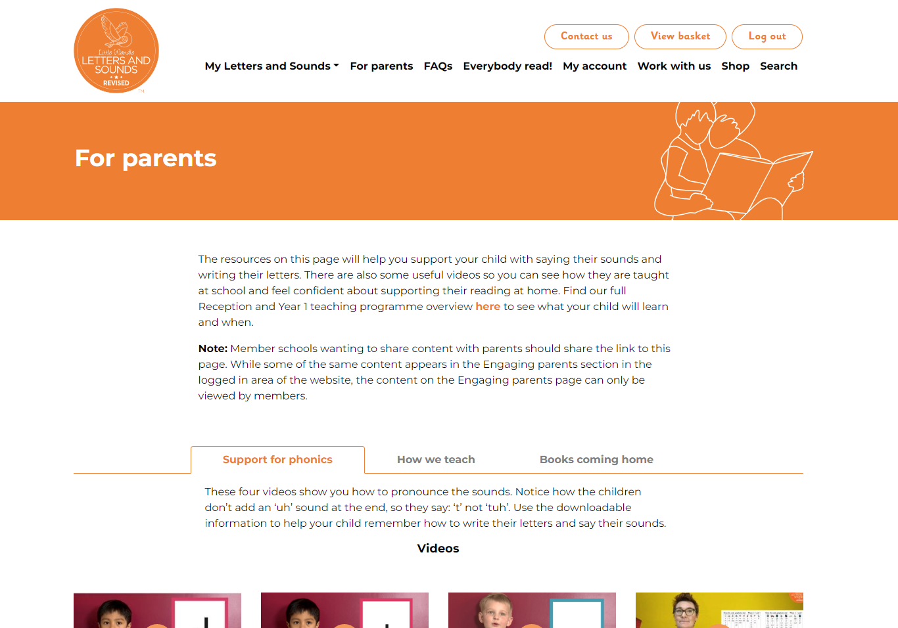
Take a look at the Little Wandle website!

Slide 14
What we teach in phonics…..and when……

Slide 15
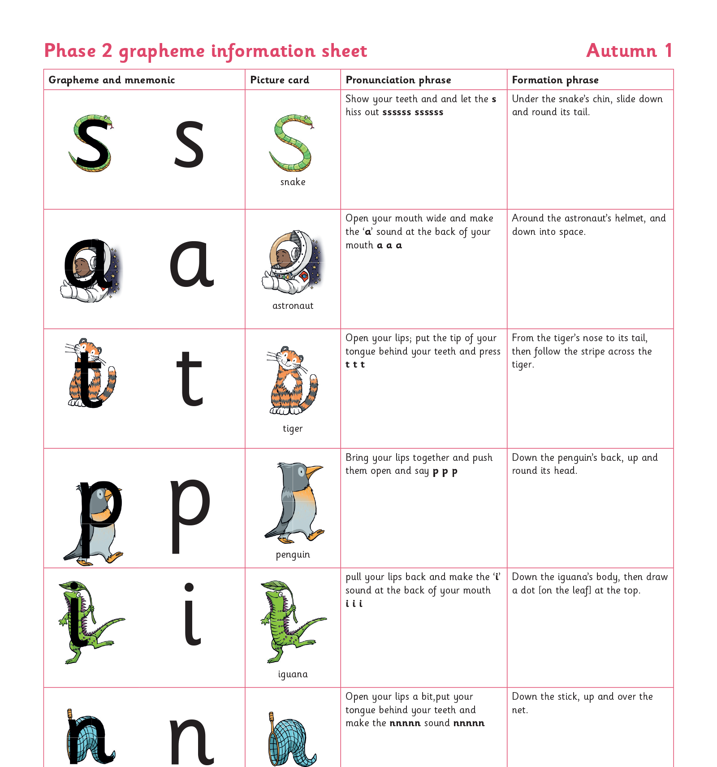
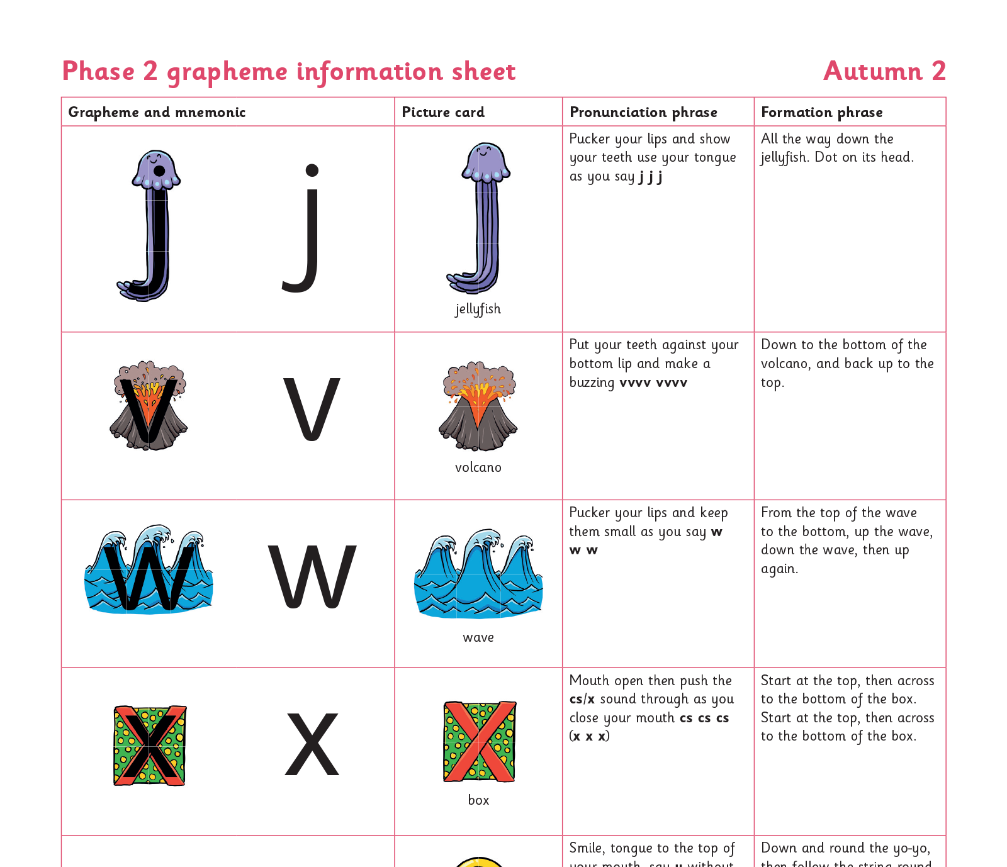
Teaching order
Notes:
We usually teach four new sounds a week and have a review lesson on a Friday. You will get a list of the sounds that we are learning to have at home. This will help you with formation and pronunciation.

Slide 16
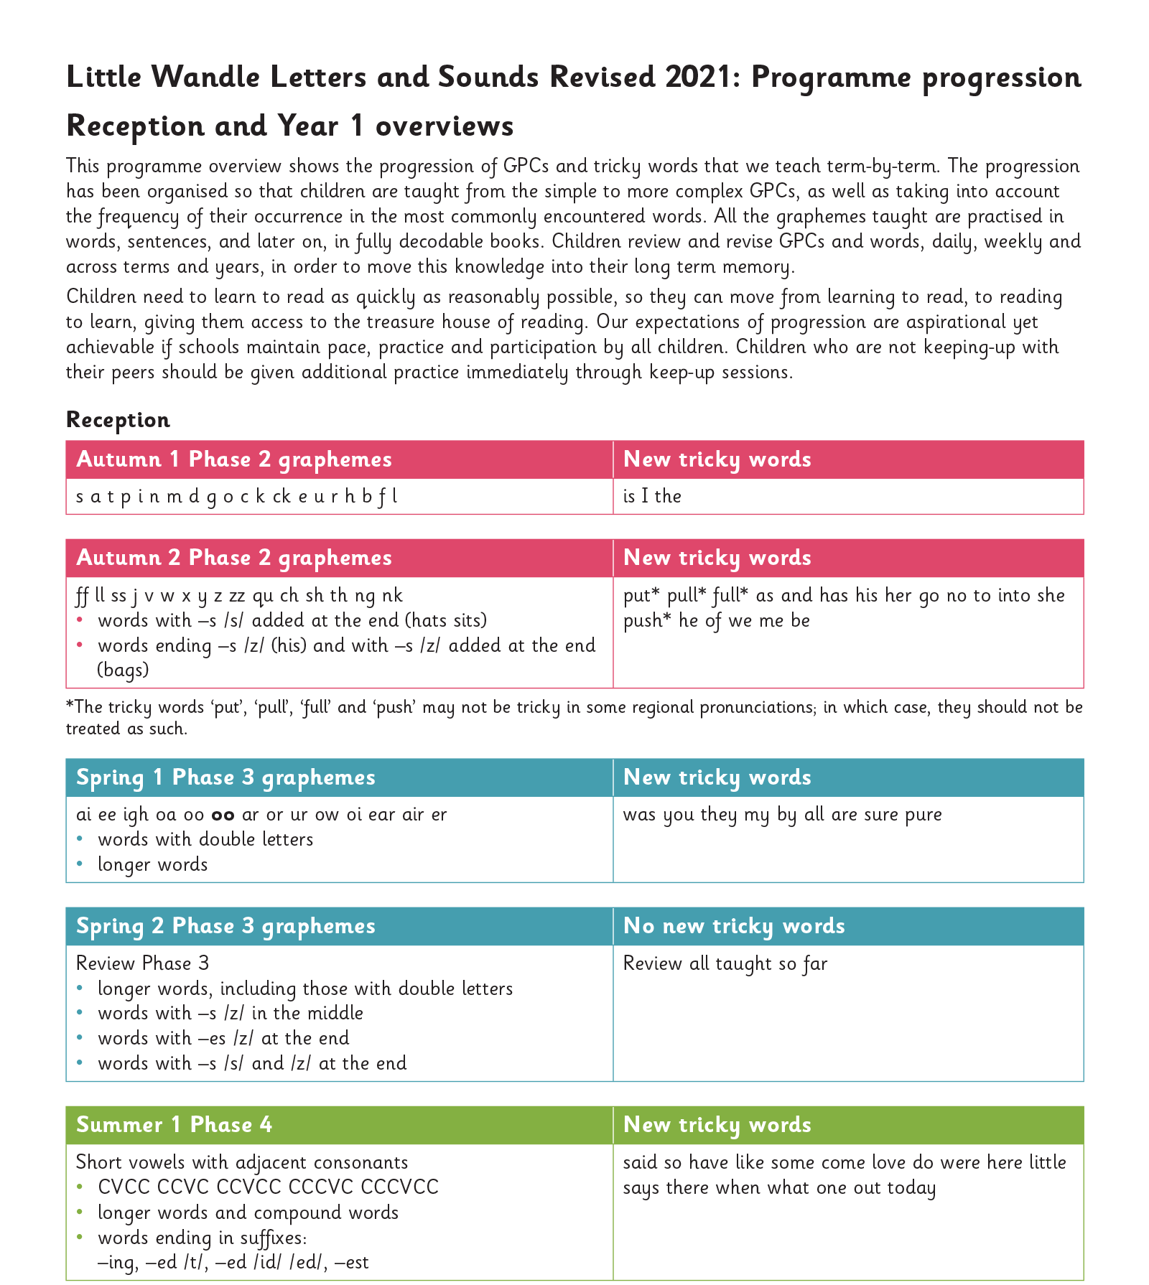
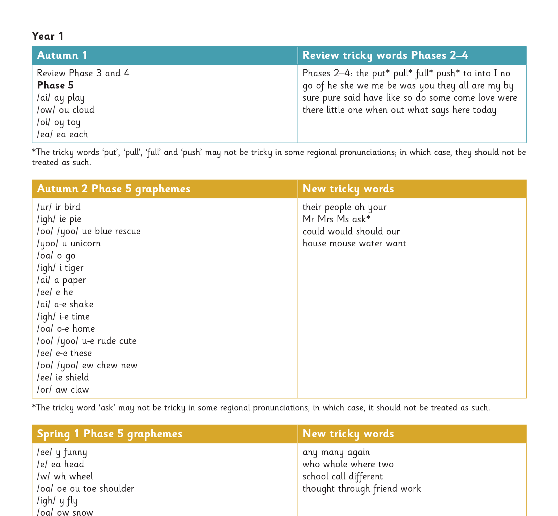
Gradually your child learns the entire alphabetic code:
Notes:
We will work our way through the whole Little Wandle Programme until your child can read fluently.

Slide 17
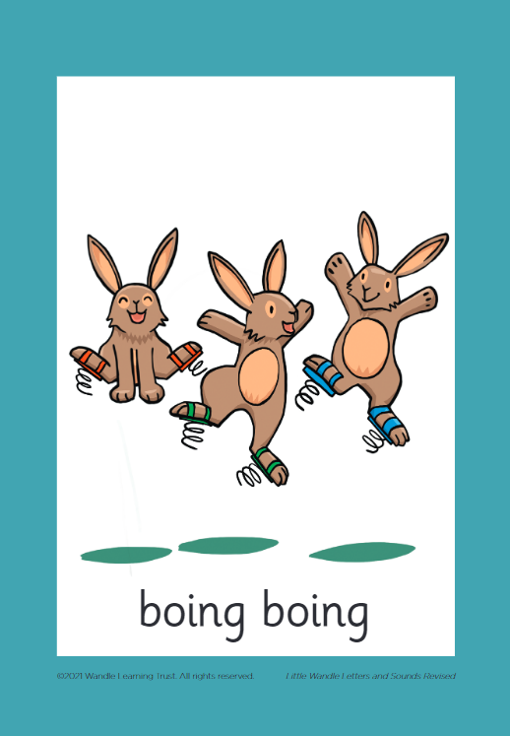



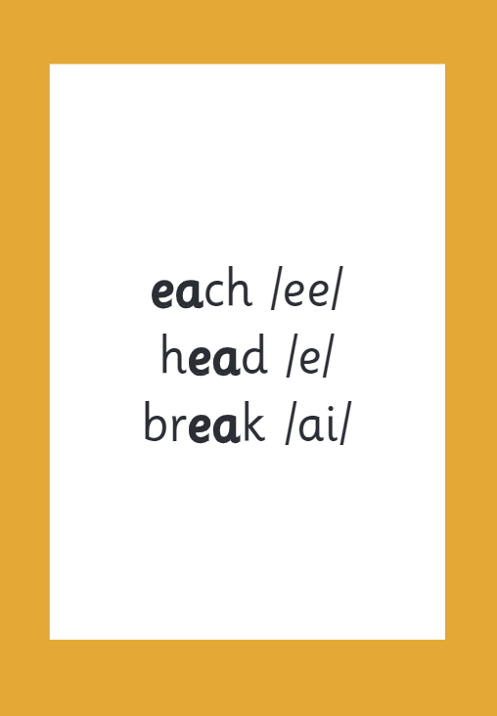

How we make learning stick
Notes:
There are specific resources for the Little Wandle Programme which the children will be very familiar with. Each sound that we teach to begin with has either a mnemonic (like the astronaut that you can see here) or a phrase like boing-boing for ‘oi’. This helps the children recognise and remember the graphemes. Every time we teach a new sound, we also read words during the phonics lesson that contain that new sound so that the children practise what they have learned. We then go on to reading a sentence containing some of those words. We have displays in the classroom and on the tables to support the children throughout the day.

Slide 18
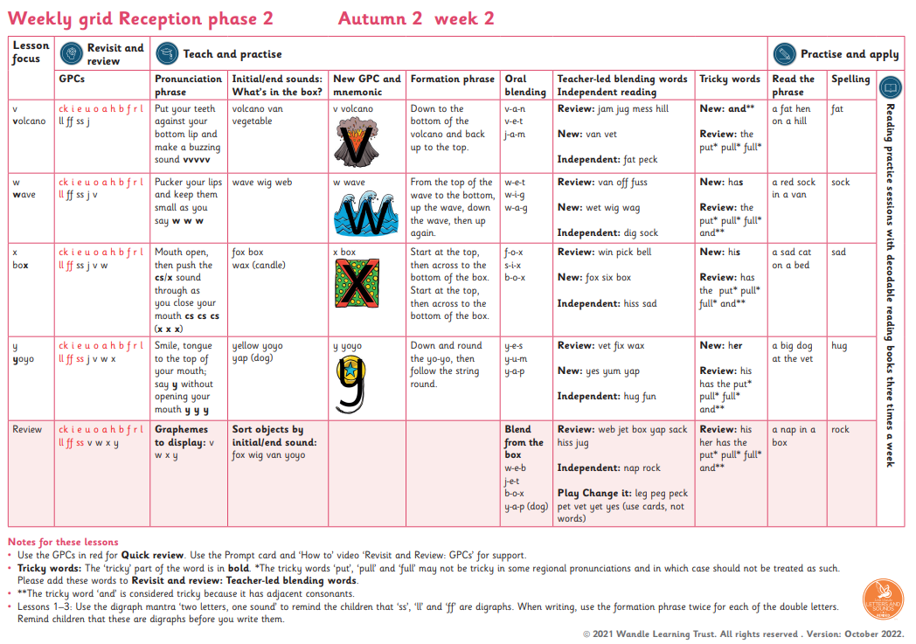

Slide 19
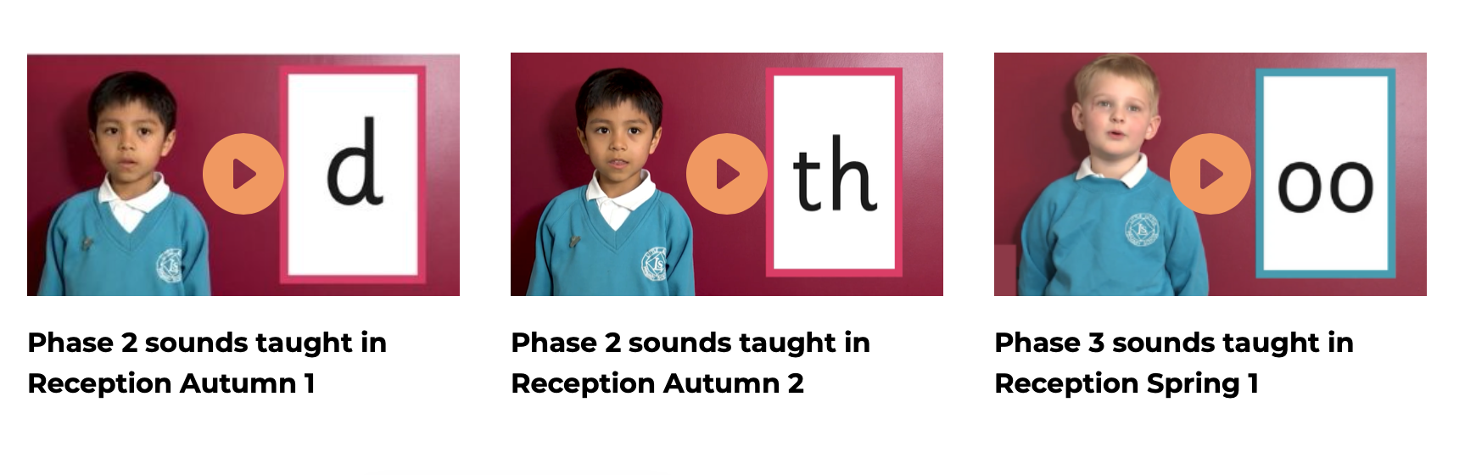
Supporting your child with phonics
Notes:
It is really important that you pronounce the sounds correctly at home if you are supporting your child. These videos are on the website for you to refer to and if you are unsure, please ask your child’s teacher.
Show the parents where to access the videos on the website and play them! https://www.littlewandlelettersandsounds.org.uk/resources/for-parents/

Slide 20
Reading

Slide 21
Reading and spelling
Notes:
This is an example of what the children learn in Year 1.
Children learn that there are graphemes that can have different sounds and sounds that can be made with different letters.
Use the backs and fronts of Phase 5 cards to show ‘ea’ and ‘ow’.

Slide 22
And all the different ways to write the phoneme sh:
shell
chef
special
caption
mansion
passion

Slide 23
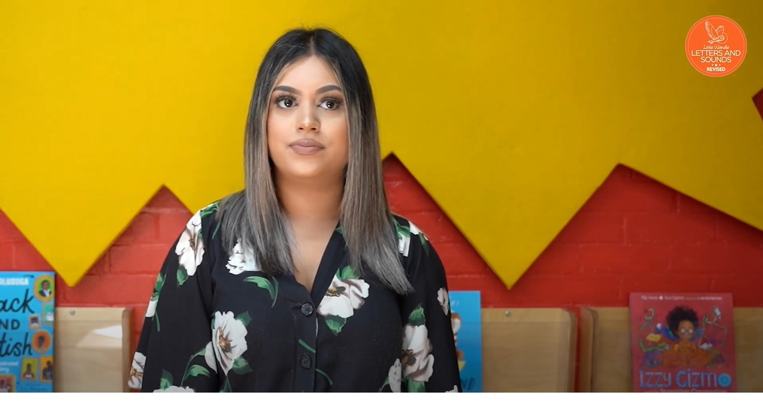
Tricky words
Notes:
Have a look at this video on the website: https://www.littlewandlelettersandsounds.org.uk/resources/for-parents/

Slide 24

Spelling
Say the word.
Segment the sounds.
Count the sounds.
Write them down.
Notes:
Model the process on a flipchart for the parents to see.

Slide 25
How do we teach reading in books at Etwall Primary?
Reading practice sessions are:
timetabled three sessions a week
taught by a trained teacher/teaching assistant
taught in small groups.
Thank you to the PTFA for funding these new books!!
Notes:
The children read the same book at least twice in a week. The first time we work on decoding (sounding out) the words, the second time we work on prosody which is reading with expression – making the book sound more interesting with our story-teller voice or our David Attenborough voice – during both sessions we are checking the children’s understanding through questioning and discussion. We read the books often at school because we want to develop the fluency. The more they see words the more they begin to read them automatically without having to sound them out.

Slide 26
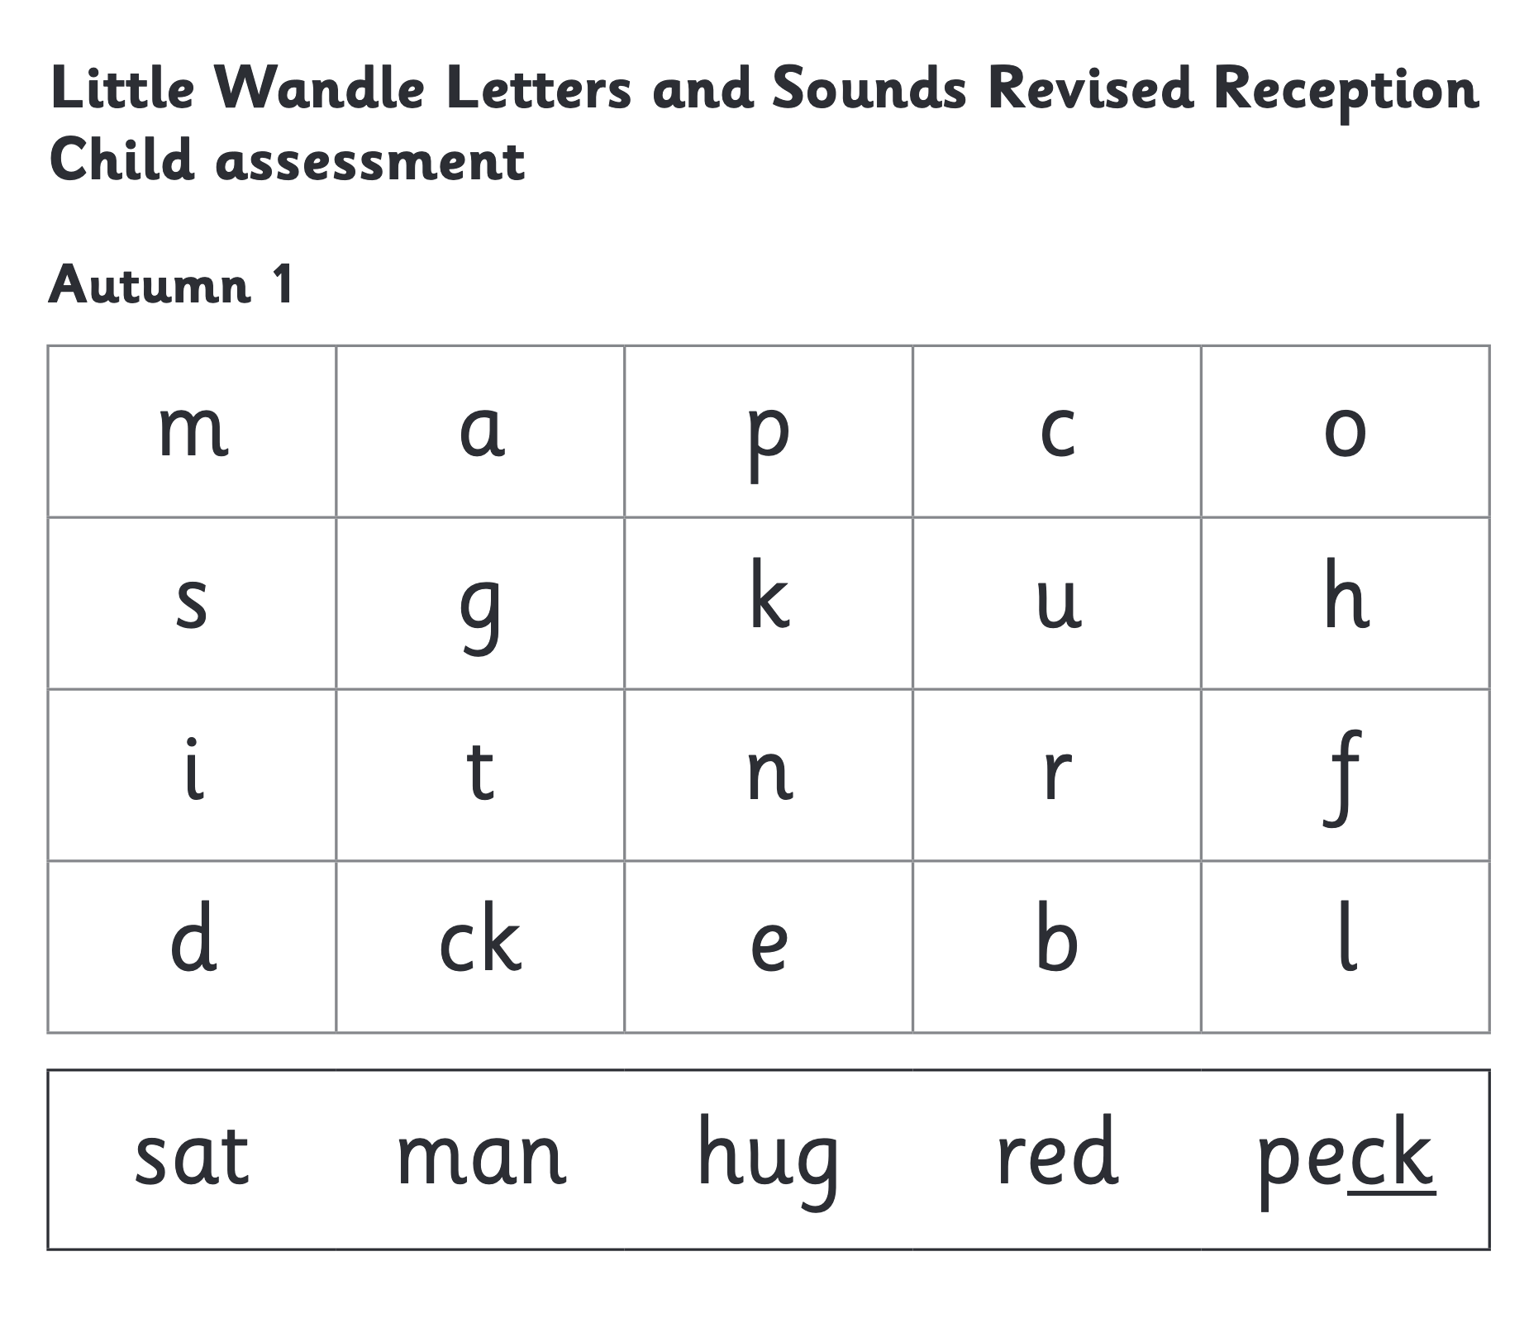
We use assessment to match your child the right level of book
Notes:
We assess your child every six weeks to check progress. Any child who needs extra support has daily keep-up sessions planned for them.

Slide 27
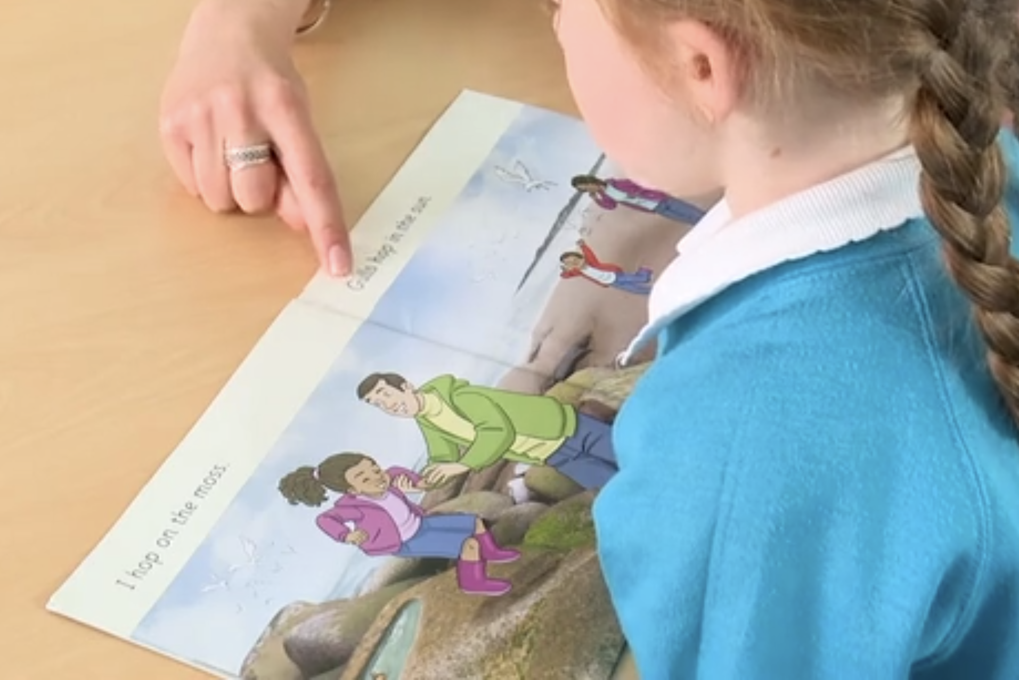
Reading a book at the right level
This means that your child should:
Know all the sounds and tricky words in their phonics book well
Read many of the words by silent blending (in their head) – their reading will be automatic
Only need to stop and sound out about 5% of the words by the time they bring the book home – but they should be able to do this on their own.

Slide 28
Reading at home

Slide 29
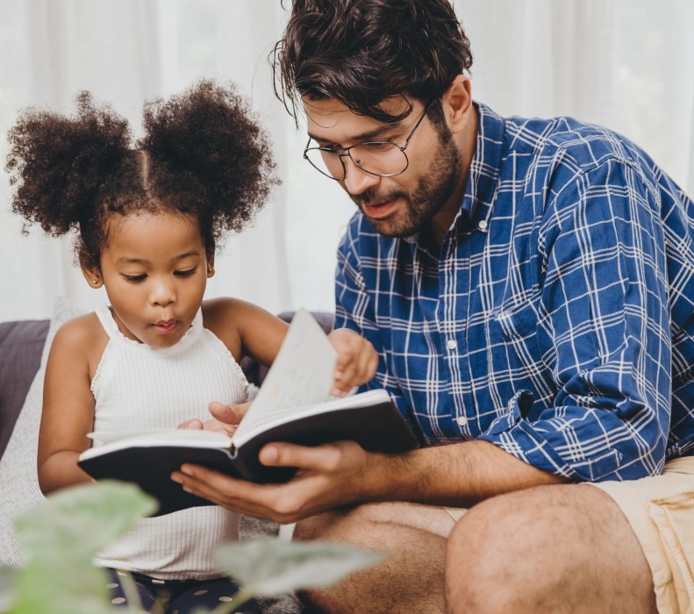
The most important thing you can do is read with your child
Reading a book and chatting had a positive impact a year later on children’s ability to…
understand words and sentences
use a wide range of vocabulary
develop listening comprehension skills.
The amount of books children were exposed to by age 6 was a positive predictor of their reading ability two years later.
Parental involvement in the development of children’s reading skills: A five-year longitudinal study (2002) Senechal, M. and Lefvre, J
Notes:
Celebrate child’s success at school, make time for reading at home!

Slide 30


Books going home (EYFS & KS1)
Sharing book
Online book
(Their reading practise session book)
Coming Soon
Physical book
(matched to child’s phonic ability)
Child should be able to read with 90% fluency and accuracy
Notes:
As well as the ‘learning to read’ book that your child will bring home they will also bring home a book for sharing with you. This book is SO important. This is how we are going to give them the WILL to read. Please read with your child as often as you can – at least once a day if possible.

Slide 31
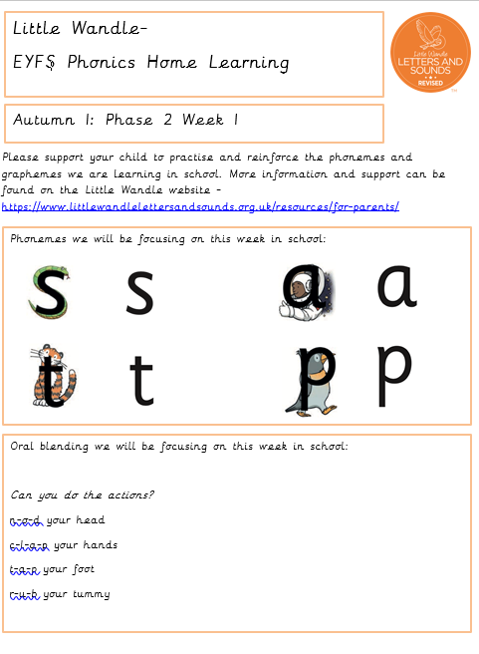
Every week you will receive a flyer like this which shows you which phonemes have been taught and words we are reading.
These will be sent to you on Google classroom – logins will be issued soon.

Slide 32
Listening to your child read their phonics book
Your child should be able to read their book without your help.
If they can’t read a word read it to them.
Talk about the book and celebrate their success.

Slide 33

Read to your child
The shared book is for YOU to read:
Make the story sound as exciting as you can by changing your voice.
Talk with your child as much as you can:
Introduce new and exciting language
Encourage your child to use new vocabulary
Make up sentences together
Find different words to use
Describe things you see.

Slide 34
One of the greatest gifts adults can give is to read to children
Carl Sagan

