Slide 1
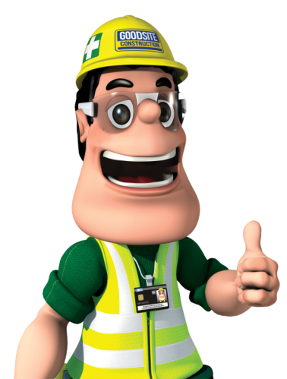
Ivor Goodsite
Presentation

Slide 2
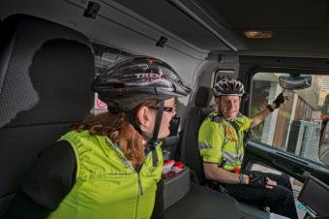
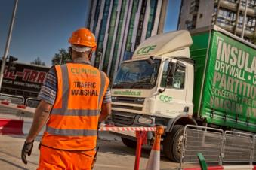
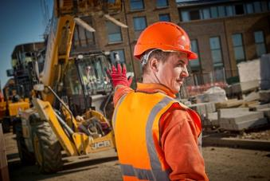
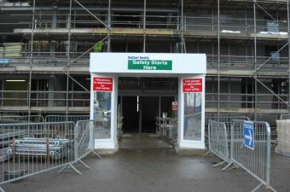
Welcome to your talk on
building site safety
Ivor Goodsite 2016
1

Slide 3

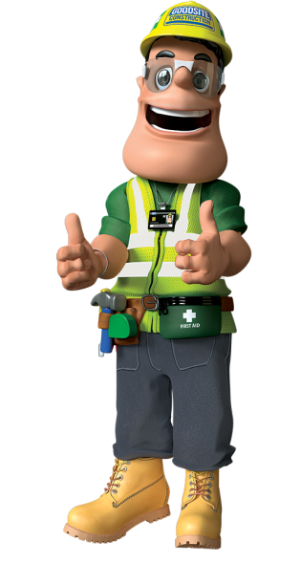
Meet
Ivor Goodsite!
Name:
Company:
Job:
Skills:
Likes:
Dislikes:
Ivor Goodsite
Goodsite Construction
Site Manager
Environmentally aware, trained first aider
Construction, big machinery, teaching children the importance of safety
Incorrect PPE, deep holes, children in danger
Ivor Goodsite 2016
2

Slide 4

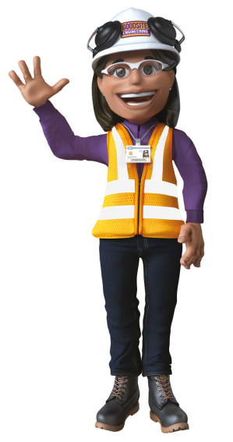
Meet
Honor Goodsite!
Name:
Company:
Job:
Skills:
Likes:
Dislikes:
Honor Goodsite
Goodsite Engineering
Structural Engineer
Excellent at problem solving, a maths and science whiz!
Art and promoting careers in construction
Untidy looking sites, litter, unfair treatment or bullying
Ivor Goodsite 2016
3

Slide 5
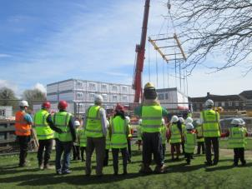


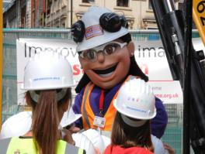
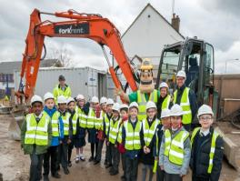
Remember…
Building sites are all around us - there may even be one close to your house or school. But remember, although they may look exciting and fun to play in, they can be very dangerous places… especially for children.
When Ivor and Honor are not working, they regularly visit schools to teach children about the dangers that can be found on building sites, and how to stay safe by staying away.
Ivor Goodsite 2016
4

Slide 6
What machinery
might you see
on a building site?
Ivor Goodsite 2016
5

Slide 7
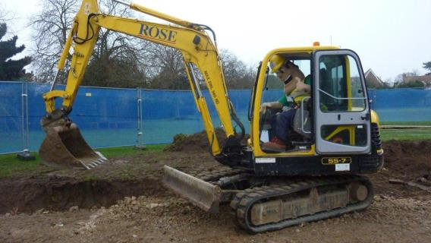
Digger
Ivor Goodsite 2016
6

Slide 8
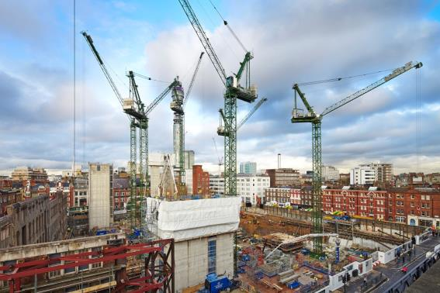
Crane
Ivor Goodsite 2016
7

Slide 9
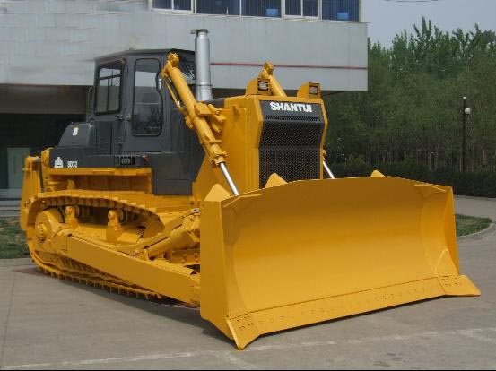
Bulldozer
Ivor Goodsite 2016
8

Slide 10
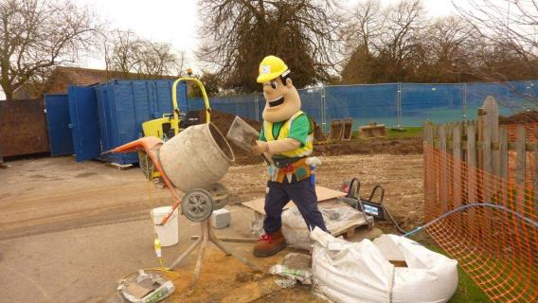
Cement Mixer
Ivor Goodsite 2016
9

Slide 11
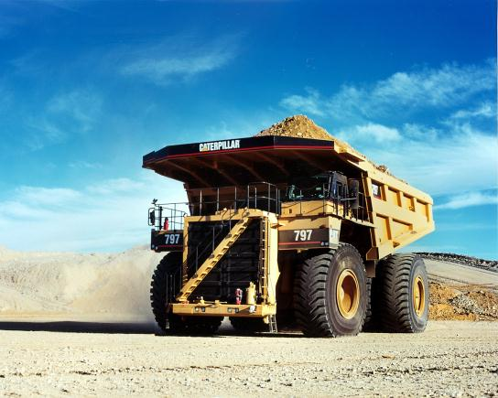
Dumper truck
Ivor Goodsite 2016
10

Slide 12
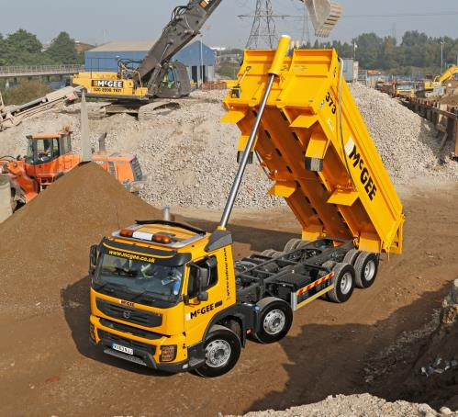
Tipper Truck
Ivor Goodsite 2016
11

Slide 13
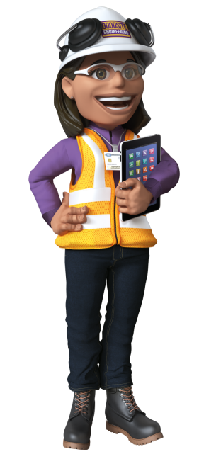
WARNING!
Although these machines may look interesting and exciting to play on, they are very dangerous and must only be operated by a trained professional.
Ivor Goodsite 2016
12

Slide 14
What dangers
could you find
on a building site?
Ivor Goodsite 2016
13

Slide 15
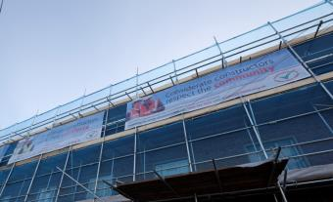
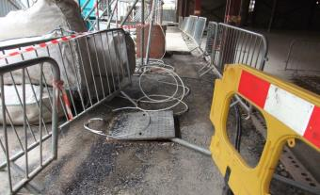
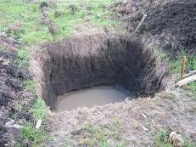
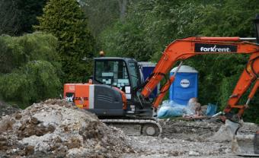
Site dangers
Scaffolding
Trip hazards
Holes
Site machinery
Ivor Goodsite 2016
14

Slide 16

How do operatives
stay safe on
a building site?
An operative is someone who works on a building site
Ivor Goodsite 2016
15

Slide 17
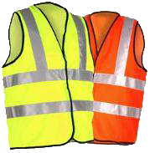

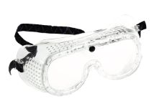
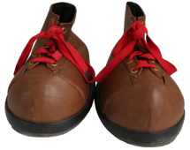
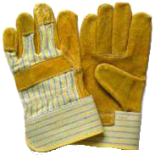
Protective clothing
Goggles
Hard hat
Hi-Viz jacket
Boots
Protective gloves
Ivor Goodsite 2016
16

Slide 18
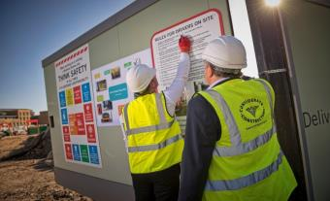
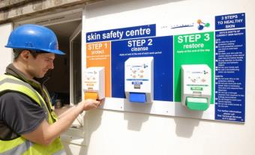
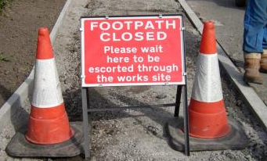
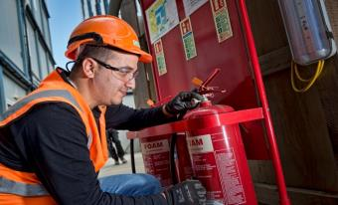
Safety equipment
Clear signage
Skin protection
Cones
Fire extinguishers
Ivor Goodsite 2016
17

Slide 19

IMPORTANT!
People working on construction sites are properly trained and wear protective clothing to stay safe.
Please stay safe by staying
away from building sites!
Ivor Goodsite 2016
18

Slide 20
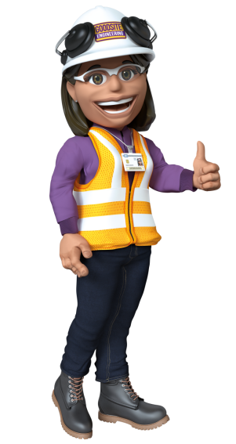
Cyclist and pedestrian safety
Remember to always be careful when walking or cycling near construction sites, making sure to look both ways at site entrances for vehicles going in and out of sites.
Always make sure to stop, look and listen before crossing the road!
Ivor Goodsite 2016
19

Slide 21

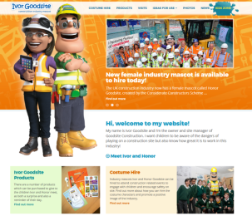

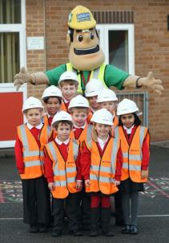
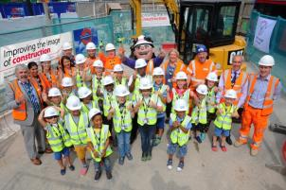
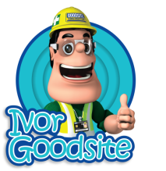

Ivor’s website
Check out:
Meet the team
Games
Activities
Ivor’s Facebook
www.ivorgoodsite.org.uk
Ivor Goodsite 2016
20

Slide 22
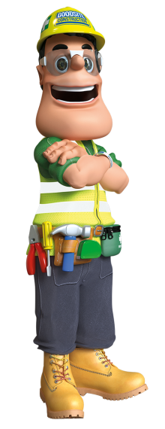
What have you learnt?
You must always read and follow safety signs – they are there to keep YOU safe!
You should always be aware of building sites around your neighbourhood and the dangers inside.
If you would like to know more about any building work in your area, you must make sure you ask a responsible adult to help you find out, instead of trying to find out yourself.
You should NEVER enter a building site without a responsible adult and the correct protective clothing.
Ivor Goodsite 2016
21

Slide 23
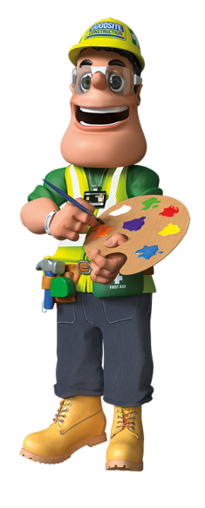


Poster competition
I would now like you to design a poster about something you have learnt today. Here are some ideas for what you could draw:
Site machinery
Protective clothing
Ivor and Honor
Building site dangers
Ivor Goodsite 2016
22

Slide 24
Question time
?
Ivor Goodsite 2016
23

Slide 25
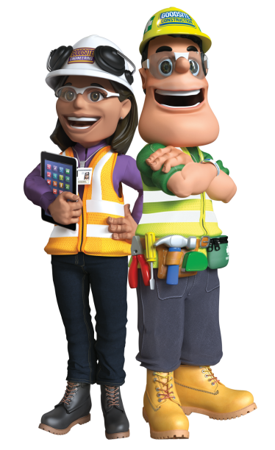
Thanks for
listening!
Ivor Goodsite 2016
24

