Slide 1
Etwall Primary School EYFS Phonics

Slide 2
Welcome
This is a presentation on how we teach phonics in Woodpeckers.
Notes:
I’m Mrs Toynbee, EYFS leader. Normally face-to-face but exceptional circumstances – online. Guide for parents on teaching phonics

Slide 3
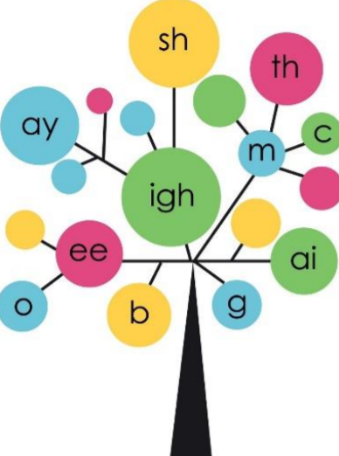
Phonics for reading
Phonics are the building blocks for children to start reading words independently.
They give children the ‘magic power’ to decode thousands of words!
It is part of an incredibly exciting stage in your child’s development.
Notes:
Phonics is the core of reading + writing.

Slide 4
Want big impact?
Use big image.

Slide 5
What is Phonics?
Phonics is recommended as the first strategy that children should be taught in helping them learn to read. It runs alongside other teaching methods such as Guided Reading and Shared Reading to help children develop all the other vital reading skills and hopefully give them a real love of reading.
Words are made up from small units of sound called phonemes. Phonics teaches children to listen carefully and identify the phonemes that make up each word. This helps children to learn to read words and to spell words.
Notes:
Phonics is not the only way we teach reading, but it gives children the tools they need to begin reading. It’s supported through class, group, individual reading sessions.

Slide 6
Phonics Phonics is taught daily to all children in Woodpeckers – although they may not always realise it! Phonics is taught as part of a broad and rich language curriculum. Daily sessions are fast-paced to ensure quick progression.
Notes:
At Etwall, we teach phonics daily in a discrete lesson, as well as integrating it into other areas of learning. It is a fun, quick session which builds on previous learning.

Slide 7
Phonics Programme
We follow the ‘letters and sounds’ programme, which is a DfE document detailing the progression children should make through ‘phases’.
Phase 1 - Preschool/Nursery
Phases 2, 3 and 4 – Reception
Phase 5 – Year 1
Phase 6 – Year 2
Notes:
These are guidelines - different children may progress through the phases at different rates.

Slide 8
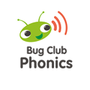
Tools used to teach phonics
Bug Club Phonics
Phonics Play
Mr Thorne does Phonics
Jolly Phonics
Big Cat reading books
Notes:
We use a variety of resources to teach phonics. We use Bug Club Phonics including reading books, Phonics Play, Mr Thorne does Phonics and Jolly Phonics to help us deliver our teaching in a fun and engaging manner.
We also use flashcards, interactive resources, spelling shed and songs.

Slide 9
How to say the sounds
Saying the sound correctly with your children is extremely important and enunciation is key.
Phonemes should be articulated clearly and precisely.
The way we say a sound may well be different from when you were at school.
You can hear the sounds here:
Articulation of Phonemes (YouTube)
Notes:
Please take some time to watch the clip before moving on.

Slide 10
How to say the sounds
We say the shortest form of the sounds with no ‘schwa’
Some sounds are bouncy: e.g., t, b, a, p
Some sounds are continuous: e.g., m, n, f, v
Notes:
Schwa is the “uh” sound in words like “about”. We have to avoid schwa e.g. muh vs mmm

Slide 11
Phonics Vocabulary
Phoneme
The smallest unit of sound in a word: e.g., s, igh or sh
Grapheme
The letter(s) that represent the sounds: e.g., s and h together make the sh phoneme.

Slide 12
Phonemes are represented by graphemes
Graphemes
These can consist of one, two or more letters.
Digraph
This is a grapheme with two letters: e.g., ng, qu, ph, er, oo
Trigraph
This is a grapheme with three letters: e.g., igh, ear, air

Slide 13
Phonics Vocabulary
CVC
This stands for Consonant-Vowel-Consonant: examples are dog, sit, mud
Blending
This is putting the sounds together to read a word.
Segmenting
This is breaking up a word into its sounds when spelling.

Slide 14
Segmenting and Blending
Children look at and read aloud each grapheme. This sounds strange, sometimes called ‘robot speak’.
The robot speaks the sounds not words: e.g., c-a-t.
They then blend the sounds together into a word: e.g., cat.
Notes:
Initially, encourage segmenting and blending when reading unfamiliar words.

Slide 15
Sound Buttons Sound buttons are used to show the letter or letters which are making a sound (phoneme). A dot is used when one letter makes a sound. A line is used when more than one letter makes a sound.
Notes:
Adding sound buttons can help children to blend sounds together to read words.
They also help ensure children don’t miss any sounds out when reading.
You can encourage your child to add sound buttons to words they are attempting to read by writing or using their fingers.

Slide 16
Phonics Phases
Understanding
the
phases
Notes:
So that’s a brief introduction to phonics, now we will talk about the DfE phases in more detail.

Slide 17
Phase 1
The first step on the phonics journey is to help children listen to the sounds in the environment and discriminate between them. For example, identifying if a car, bus or motorbike has driven past.
The main aim is for children to experience regular opportunities to listen carefully and talk about what they hear, say and do.

Slide 18
Phase 1
Phase 1 begins in Nursery/Pre school but continues to be taught alongside Phases 2 and 3 throughout Reception.
Rhyme and rhythm, alliteration (e.g. postman Pat) and oral blending and segmenting are key aspects in this phase.
Example: P-u-sh the door.

Slide 19
Phase 2
Children are taught the phonetic sounds first, then how to match them to letters.
Finally children learning how to use the letter sounds for reading and spelling. We call this blending and segmenting.
Children are encouraged to make good guesses at this stage using the sounds they know.
Children begin to learn high-frequency, tricky, words such as I, to, the, go, no.

Slide 20
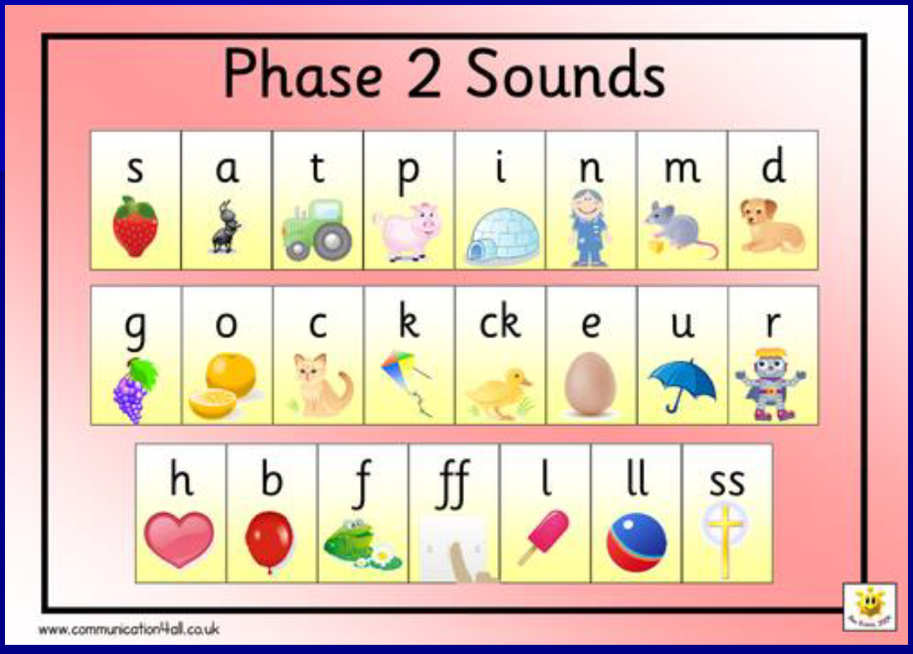
89,526,124
Whoa! That’s a big number, aren’t you proud?
Notes:
Here are the Phase 2 sounds.

Slide 21
Phase 3
Phase 3 introduces twenty-five new graphemes one at a time.
Most of these graphemes are digraphs (consisting of two letters).
During Phase 3, children will also learn the letter names and continue to consolidate the sounds learnt in Phase 2.
The children begin learning tricky words (see later).
Notes:
Most children will leave Reception having completed Phase 3, but phonics will continue throughout Key Stage 1, up to Phase 6. The next few slides outline the remaining phases.

Slide 22
89,526,124
Whoa! That’s a big number, aren’t you proud?
Notes:
Here are the Phase 3 sounds.

Slide 23
Phase 4
By the end of Phase 3, children are able to represent each of the 44 phonemes in the English language by a grapheme.
Children are able to blend and segment CVC words for reading and spelling: e.g., pit, zip.
Phase 4 consolidates this knowledge and children begin to read and spell CVCC and CCVC words such as push, trip.
They start to read and spell some very long words with their new knowledge!

Slide 24
Phase 5
Children learn alternative pronunciations of graphemes: e.g., ow in cow and ow in crow
They also learn alternative graphemes for the same phoneme: e.g., ay, eigh, ai, a-e, ei, ey
Quicker recall of graphemes, especially blending them in longer words.
Ultimate goal is for children is to read decodable and tricky words effortlessly and automatically.

Slide 25
89,526,124
Whoa! That’s a big number, aren’t you proud?

Slide 26
Phase 6
Children at this stage can read hundreds of words automatically.
They can decode words quickly and silently which helps them to become increasingly fluent readers.
They can spell phonetically accurately and now work on choosing the correct grapheme for words they wish to spell.

Slide 27
Exception words
Not all words can be segmented and blended.
We call words ‘tricky words’, e.g. the, to, no, and I
Children have to learn to sight-read these words.
Notes:
Not all words can be segmented and blended, and many of these words are very common. We call these high-frequency or tricky words. These words need to be learnt by sight through practice.

Slide 28
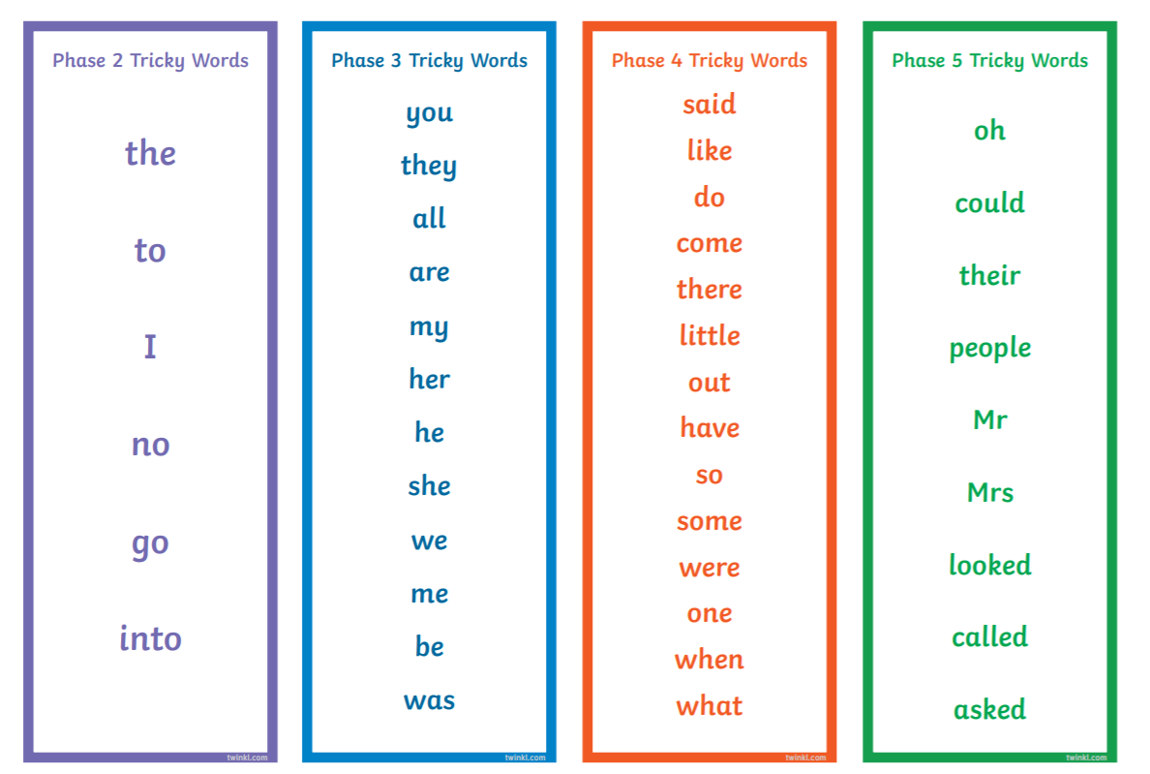
Exception words

Slide 29
Reading
Phonics is taught daily and includes opportunities to read words and phrases / sentences.
Our reading books are linked to the phonemes that are taught in school.
Children also read individually with staff in school at least once a week.
There are many opportunities to read a variety of books throughout the day.
Our expectations are that children will read regularly at home, both the ebook on Bug Club and a actual book in the reading folder, at least five times a week.
Children are supported to learn exception words and phonemes at home using the keyrings provided.
Notes:
In our daily phonics session, we have opportunities to read words, captions and sentences. There are many other opportunities to read throughout the day within literacy lessons, story time and continuous provision.

Slide 30
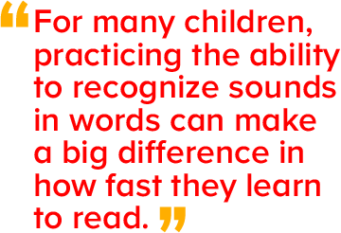

Slide 31
How to help at home
Enthusiasm, encouragement and praise are key!
Practise and recap old and new sounds.
Sing the alphabet, play I-spy, spot sounds or rhymes in books, etc.
Ask children to find objects around the house or in your environment that represent sounds: e.g., ‘oo‘ in spoon or bedroom.
Play matching pairs with key words or tricky words or play ‘tricky word bingo’.
Make sentences or silly sentences.
Practise reading letter sounds and words – using the keyrings provided.
Handwriting
Practise reading (and spelling) tricky words – using the keyrings provided
Reading anything and everything your child enjoys!.
Notice letters or words in the environment.
Go on a listening walk around the house or when you’re out and about.
Talk about books (stories, characters, make predictions, etc.) or other materials read such as leaflets.
Tell stories to children – try retelling a favourite fairy tale with a different ending.
Encourage a love of reading!
Notes:
Here are some suggestions of how you can support phonics and reading at home.

Slide 32
Thank you
Any questions?
Contact Woodpeckers on Class Dojo
Notes:
Thank you for your time and support, and we’re always available to answer any questions you may have.

